Slide 1
Women Role Models in STEM

Slide 2
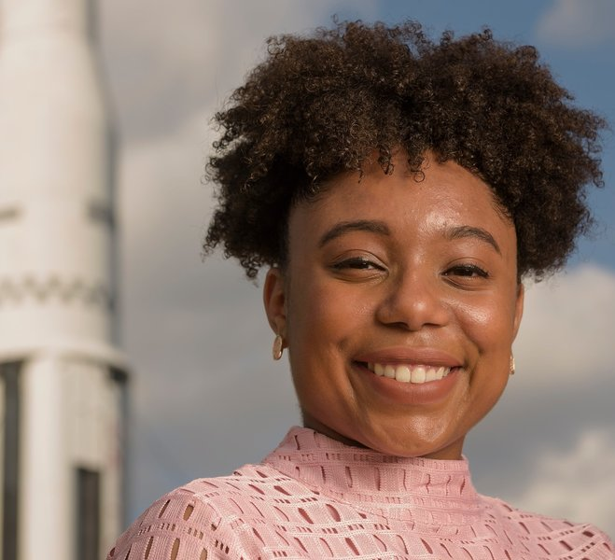
Tierra Fletcher (Guinn)
An African American engineer who graduated from MIT in 2017 and now works for Boeing
She is one of the designers and structural analysts building the Space Launch System for NASA which is set to send people to Mars
She is only 22 years old
“You have to look forward to your dream and you can’t let anybody get in the way of it,” she said. “No matter how tough it may be, no matter how many tears you might cry, you have to keep pushing. And you have to understand that nothing comes easy. Keeping your eyes on the prize, you can succeed.”

Slide 3
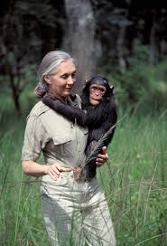
Jane Goodall
An English primatologist, ethologist and anthropologist
Best-known for conducting a forty-five year study of chimpanzee social and family life
In 1977, she founded the Jane Goodall Institute to support the research in Gombe and scale up the protection of chimpanzees in their habitats
She is now 86 years old
Today she travels the world, speaking about the threats facing chimpanzees and environmental crises, urging each of us to take action on behalf of all living things and planet we share

Slide 4
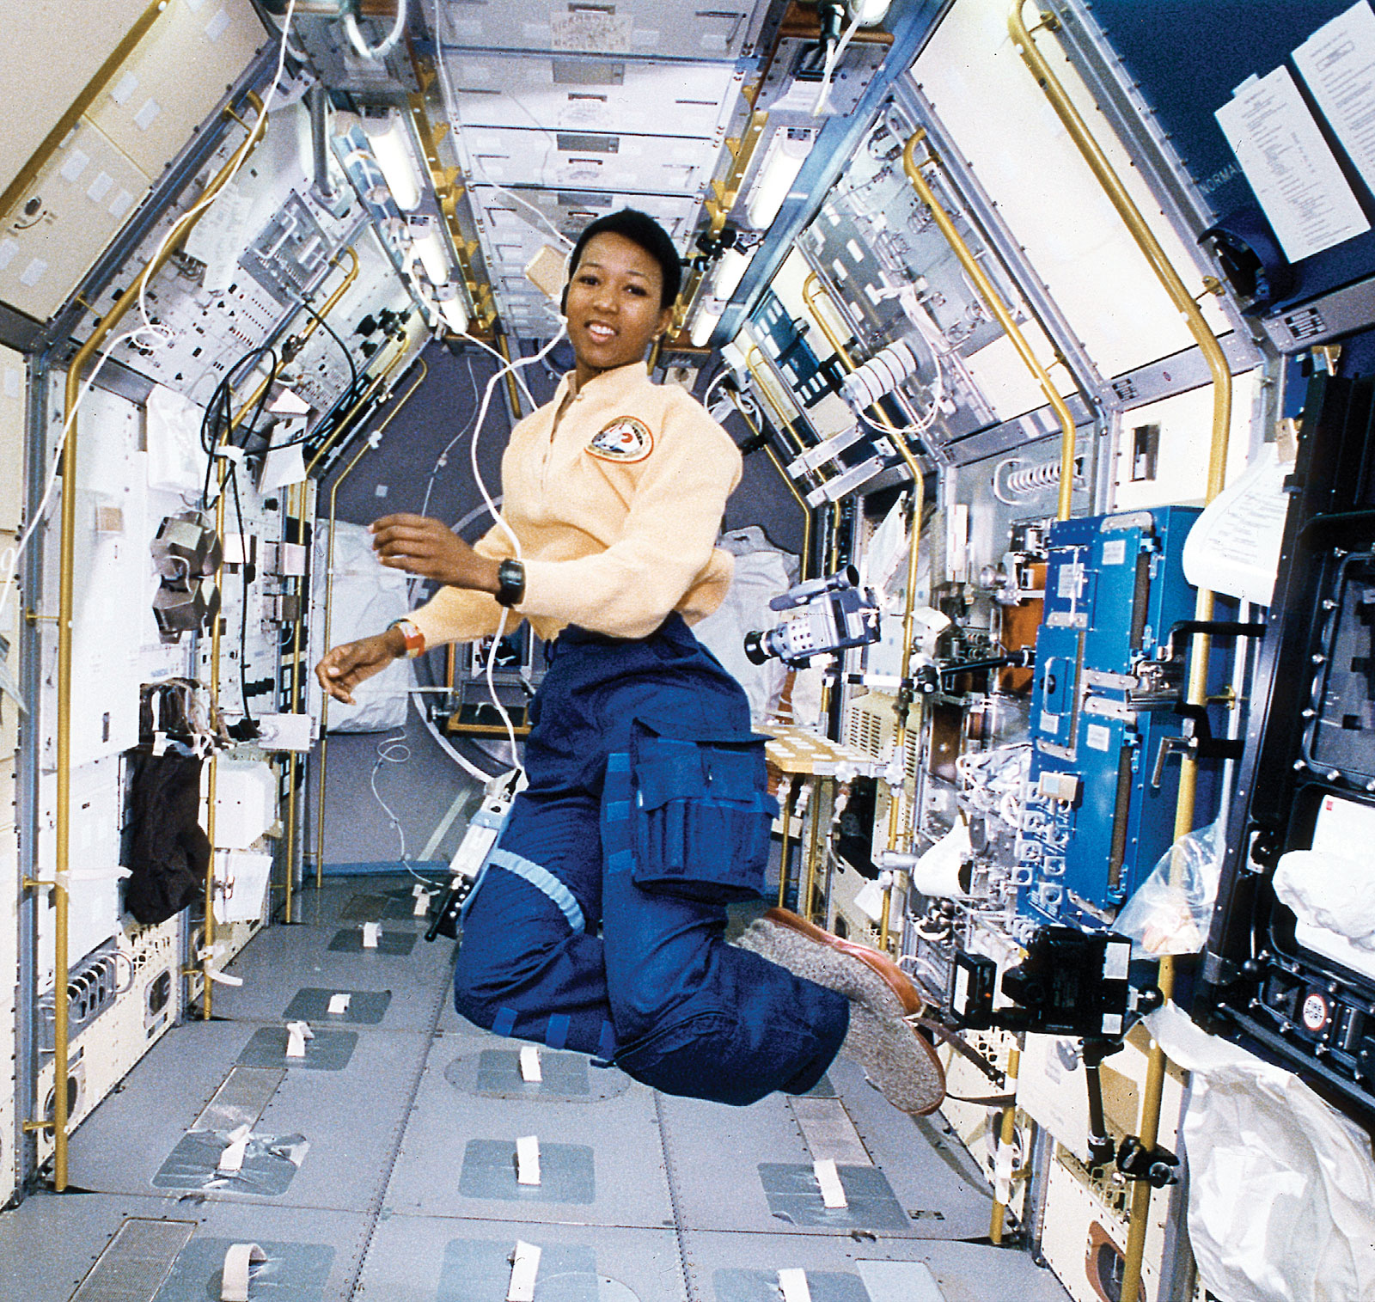
Mae C. Jemison
An American engineer, physician, and former NASA astronaut
She became the first black woman to travel into space when she served as a mission specialist aboard the Space Shuttle Endeavour
Before entering the space program, she was a medical doctor who served with the Peace Corps in Sierra Leone and Liberia
She is now 64 years old
Currently she is leading the 100 Year Starship project through the United States Defense Advanced Research Projects Agency

Slide 5
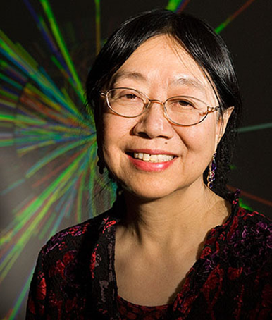
Sau Lan Wu
Sau Lan Wu is a Chinese American particle physicist and the Enrico Fermi Distinguished Professor of Physics at the University of Wisconsin-Madison
Her work at CERN contributed to the discovery of the Higgs boson, one of 17 fundamental particles
Sau Lan Wu spent decades working to establish the Standard Model of particle physics. Now she’s searching for what lies beyond it.

Slide 6
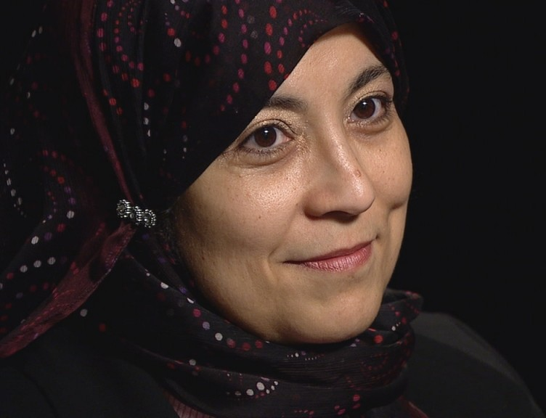
Tahani Amer
An American Muslim that works at NASA who grew up in a suburb of Cairo, Egypt
Dr. Amer started working at NASA in the Computational Fluid Dynamics (CFD) and moved to wind tunnel tests
In 2001, she patented an invention that measures the thermal conductivity of thin films, which has implications in transistors, optical coatings, and thermoelectric energy conversion.
She’s involved in several community service programs, including NASA’s “Day of Caring,” Diversity Day, and after-school science clubs.

Slide 7
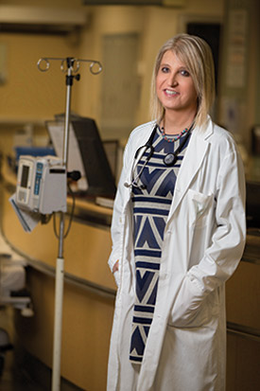
Dr. Carys Massarella
Known today as a “trans-warrior physician,” Dr. Massarella joined the St. Joseph’s team in Hamilton, Ontario, in 1997 and has held various positions throughout the years including Chief of Emergency Medicine, and President of the Medical Staff Association
Currently practices as a medical physician at St. Joseph’s and is the lead physician at the Quest Community Health Centre, a transgender care clinic in St. Catherine’s
She is 49 years old

Slide 8
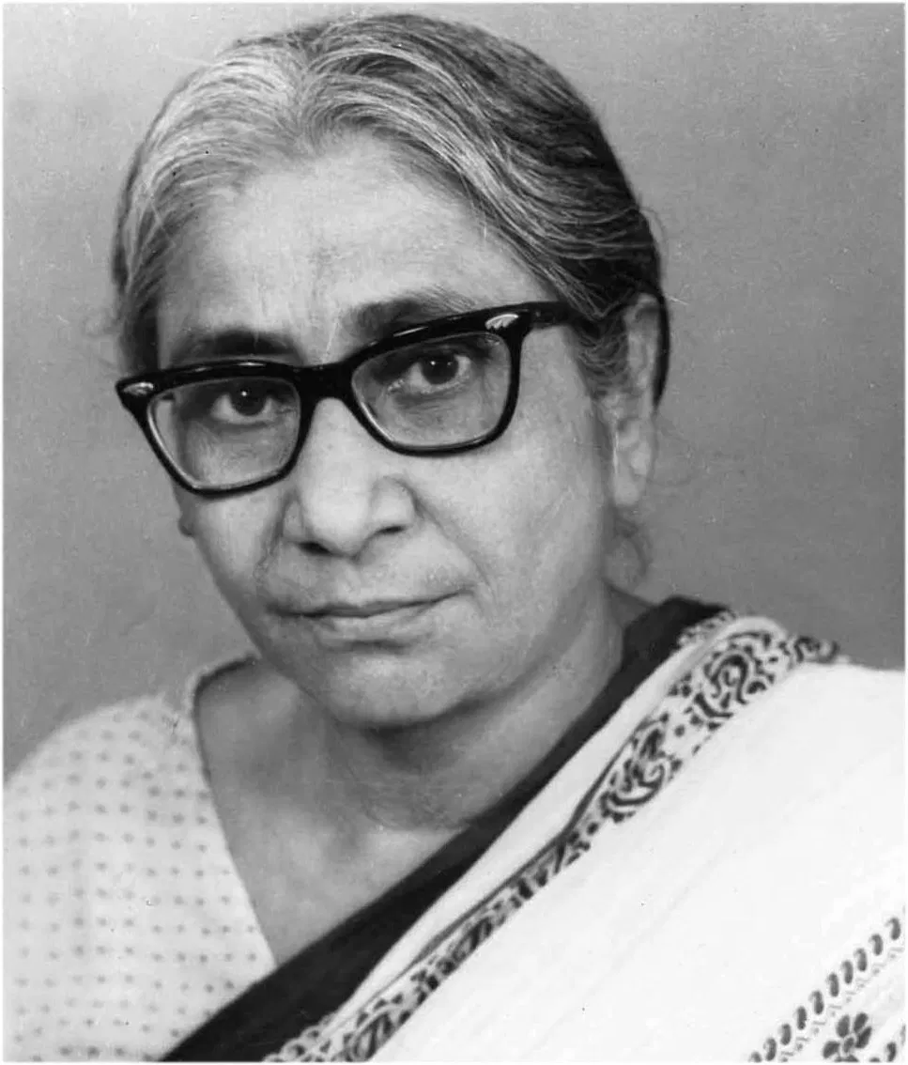
Asima Chatterjee
An Indian chemist, she is regarded highly for her works in the fields of organic chemistry and phytochemistry (chemicals derived from plants)
She graduated in chemistry from the Scottish Church College of the University of Calcutta in 1936 and then pursued research
Her most notable work includes research on vinca alkaloids (derived from the periwinkle that is known for its anti-cancer properties), and the development of anti-epileptic and anti-malarial drugs

