Slide 1
Asian and Asian American STEM Role Models

Slide 2
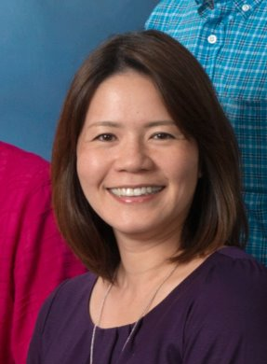
Keiko Nakamura-Messenger
She is a cosmochemist and materials scientist in the Astromaterials Research Exploration Science Directorate at NASA’s Johnson Space Center. She received her Ph. D. in Material Science from Kobe University, Japan. She is currently the lead of the Sampling Site Science Working Group and the deputy curation lead for NASA's asteroidal sample return mission OSIRIS-REx. She is NASA's sample curator for JAXA's asteroidal sample return mission Hayabusa2. Nakamura-Messenger is the Deputy Principle Investigator for the NASA New Frontiers CAESAR (Comet Astrobiology Exploration Sample Return) mission. She has extensive experience with the curation and analysis of extraterrestrial materials, including Stardust mission samples, interplanetary dust particles and primitive meteorites. She is the lead discoverer of two new minerals, Brownleeite (MnSi) and Wassonite (TiS). Asteroid 7862 Keikonakamura (1981 EE28) is named after her for her work that revealed the existence of organic globules in meteorites, furthering understanding of organic material in the solar system.

Slide 3
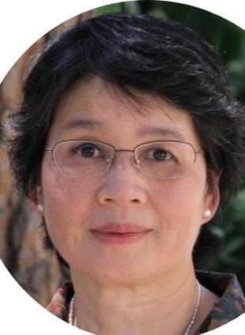
Margaret Wu
Wu is a professor emeritus at the University of Melbourne and is a leader in the field of education statistics. She made her start in the 1970s as a research assistant at Monash University, programming statistical analyses. In that position, Wu designed and programmed statistical analyses for numerous publications across disciplines. Like other women research assistants in that era, Wu’s contributions were recognized in acknowledgements, rather than with authorship. After having twins, she took a career hiatus but eventually took a job as a math teacher in a private high school. Later, she worked at ACER, Australian Council for Educational Research while also achieving her masters and Ph. D.

Slide 4
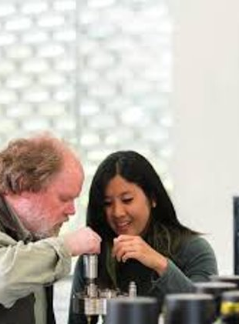
Thi Truong
First year Ph. D. student in Geology at Oregon State University. She uses the tools of geochemistry and igneous petrology to study intraplate volcanism at ocean island chains like the Hawaiian Islands, and the Juan Fernandez Islands. She received her master’s and bachelor’s from the University of California at San Diego.

Slide 5
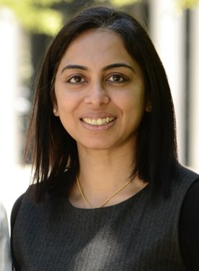
Yamuna Krishnan
She is currently a chemistry professor at the University of Chicago and the chief science officer of the start-up Esya Labs. Krishnan founded Esya Labs in 2018 with her business partner who lives in London. While working at the National Center for Biological Sciences in Bangalore, India, after her postdoc, Krishnan realized that the DNA-based fluorescence sensors she was designing could potentially be used to diagnose diseases. So, she took the leap and moved to the University of Chicago, where she knew she could make connections to bring the sensors to patients. Her group there has since developed DNA-based sensors to measure pH and chloride ions. The scientists use DNA as a “coat hanger” onto which they can add groups such as ion sensors and recognition elements to get the nanodevices inside cells. Esya has three areas of focus. The company is using its lysosomal ion-concentration technology to analyze tissue from clinical trial participants to determine whether patients respond to a drug and to divide the patient population into disease subtypes. It is also helping pharmaceutical firms screen for small molecules that target disease-related ion channels and transporter proteins in cells. And third, the company is working with a partner in India on diagnostics for rapid detection of bacteria and antibiotic resistance.

Slide 6
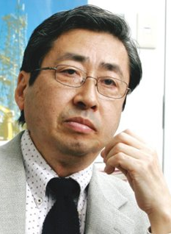
Asahiko Taira
Taira has spent 40 years doing geological research and worked as an assistant professor at Kochi University. He was also a professor at the University of Tokyo and has been published in more than 200 American and Japanese publications. The Asahiko Taira International Scientific Ocean Drilling Research Prize is dedicated to supporting other geologists and earth scientists. Taira received his bachelors of science from Tohoku University, Japan and his Ph. D. in geology from the University of Texas at Dallas.

Slide 7
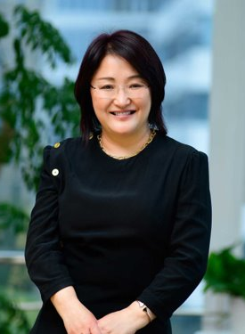
Samantha Du
Du is one of the most notable and accomplished entrepreneurs in China. She’s built more than one company from scratch, the latest being Zai Lab, and worked as an investor herself. She’s a mentor and a role model. After earning her PhD from the University of Cincinnati, Du worked at Pfizer bringing antibiotics to market. In 2001, after 7 years at Pfizer, she moved back to China with her young family to help the multinational conglomerate Hutchison Whampoa build its drug discovery branch. The company she built, Hutchison MediPharma, developed multiple cancer drugs that were in clinical trials by the time she left. Next, she spent 2 years at the multinational firm Sequoia Capital as a venture capitalist, specializing in investments in China. A drug for recurrent ovarian cancer was approved for use in China at the end of 2019.

Slide 8
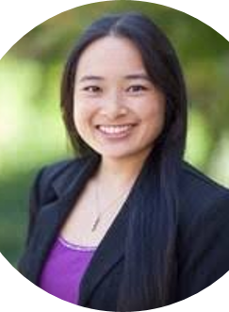
Sarah Wright
Senior Scientist for vaccine development at Merck, a biopharmaceutical company in Pennsylvania. Wright received her Ph.D. from the University of Notre Dame. Among her many accolades, she was awarded Best Forensic Poster in 2019 for, “Battling the Backlog: Capillary Zone Electrophoresis Automated Fraction Collection for the Forensic Analysis of Sexual Evidence.” In doing this, the final result contains a primarily male mixture of DNA that requires a trained analyst in short tandem repeat (STR) mixture interpretation for perpetrator identification. Her work helps to address the national backlog of untested rape kits.

Slide 9
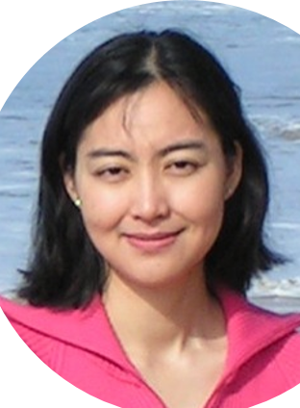
Enyue (Annie) Lu
Professor of math and computer science at Salisbury University in Maryland. She received her Ph. D. From the University of Texas at Dallas. Her research interests lie in high performance computing, computer and communication networks, algorithm design and analysis, and graph theory.

