Slide 1
Black and African American STEM
Role models

Slide 2
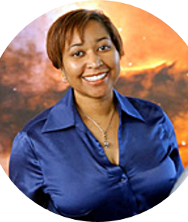
Beth Brown
Brown graduated Summa Cum Laude with a degree in Astrophysics from Howard University in Washington, DC.. She went on to grad school at the University of Michigan, becoming the first African-American female to get an Astronomy PhD there. After graduating, Brown went on to work as an astrophysicist at NASA. She collected data on the environment of elliptical galaxies. Elliptical galaxies are thought to be the result of two smaller galaxies merging, and each is believed to contain a supermassive black hole in its center.

Slide 3
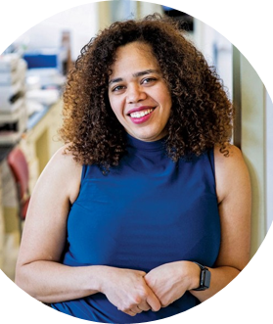
Sarah Richardson
Richardson is the CEO and founder of MicroByre, a bioengineering company which seeks to convert non-model species into genetically tractable strains within which the techniques from model organisms can be practiced. Byre means “cowshed” in Old English, her vision for MicroByre was to be a bacterial barn where bioengineers turn wild microbes into useful chemicals. For example, E. coli has difficulty converting biomass to petrochemicals, a task that Richardson hopes microbes might one day take on. You can’t make E. coli betray their nature and eat anything other than sugar, Richardson explains. Biomass such as lignin would be a cheaper, more sustainable feedstock. But if you want a microbe to change what it’s producing and change what it’s eating, it would require too many genetic edits. The process would fail. That’s where Richardson’s wild-microbe barn comes in. With a team of chemists, microbiologists, and software engineers, MicroByre aims to find the right bacterium for each job and coax it, with minimal editing, to work in industrial environments.

Slide 4
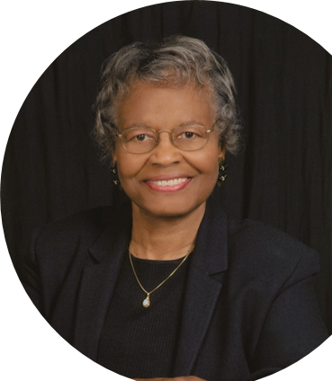
Gladys West
Hired at the Naval Surface Warfare Center in Dahlgren, Virginia in 1956, West worked as a programmer and analyzed satellite data. She was able to use satellite data to put together altimeter models of the Earth’s shape with extreme precision. She was then recommended to work as the project manager for the Seasat radar altimetry project, the first satellite that could remotely sense oceans.
Through the mid-70s and 80s, Dr. West programmed an IBM computer to provide extremely precise calculations to model the shape of the Earth, a geoid, optimized for what eventually became the Global Positioning System (GPS) orbit.

Slide 5
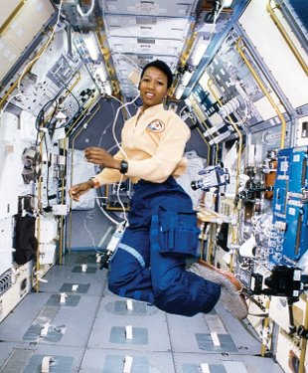
Mae Jemison
The first African-American woman to fly in space, Mae Jemison (1956-) holds a B.S. in chemical engineering. In 1992, she served on an eight-day Space Shuttle mission that conducted microgravity investigations in materials and life sciences while orbiting Earth 127 times. Jemison was a co-investigator on the bone cell research experiment flown on the mission. She was also the first astronaut to appear on Star Trek.

Slide 6
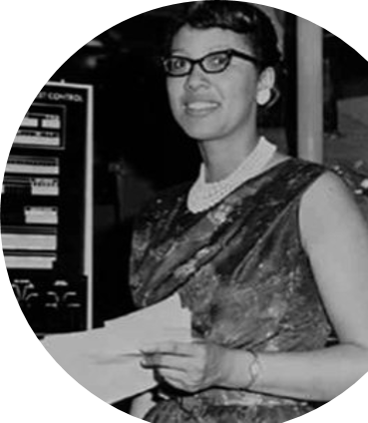
Dorothy Vaughan
Vaughan came to the Langley Memorial Aeronautical Laboratory in 1943, during the height of World War II, leaving her position as the math teacher at Robert Russa Moton High School in Farmville, VA. Vaughan was assigned to the segregated "West Area Computing" unit, an all-black group of female mathematicians, who were originally required to use separate dining and bathroom facilities. She was promoted to lead the group, making her the NACA's first black supervisor, and one of the NACA's few female supervisors. The Section Head title gave Dorothy rare Laboratory-wide visibility, and she collaborated with other well-known (white) computers like Vera Huckel and Sara Bullock on projects such as compiling a handbook for algebraic methods for calculating machines.

Slide 7
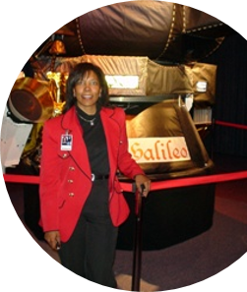
Claudia Alexander
Alexander is a Geophysicist. After a high school summer internship in the engineering department at NASA’s Ames Research Center, Alexander became more interested in earth-science and majored in geophysics at UC-Berkeley. Alexander then worked at NASA’s Jet Propulsion Laboratory where she contributed to many different missions and showed her expertise in areas such as studying comets and understanding solar wind. She was the project manager of the Galileo mission, the goal of which was to make the first study of Jupiter and its moons and magnetosphere from orbit. She then was the project scientist of the Rosetta mission, which aimed to make a detailed study of a comet and was the first mission designed to orbit and land on a comet.

Slide 8
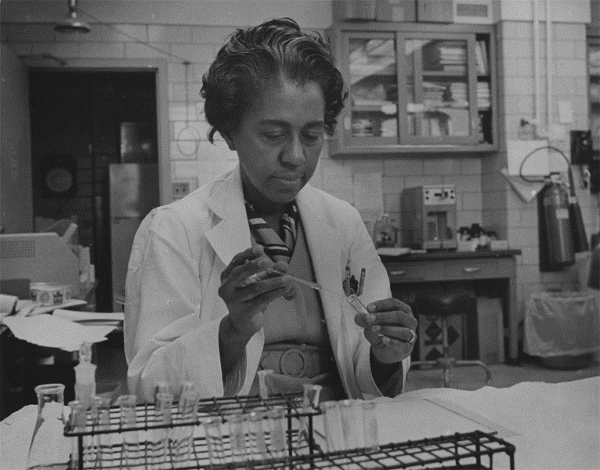
Marie maynard daly
Daly was the first Black woman to earn a PhD in Chemistry in the United States.
She earned her doctorate from Columbia University.
Her graduate research about the workings of digestive enzymes and her postdoctoral research about the cell nucleus helped scientists understand histones, proteins that both aid in the organization of our genomes and influence gene expression.
Daly showed that high blood pressure led to clogged arteries and that high levels of cholesterol are an important contributor to metabolic disease.
Daly also taught at Howard University and Albert Einstein College of Medicine.

Slide 9
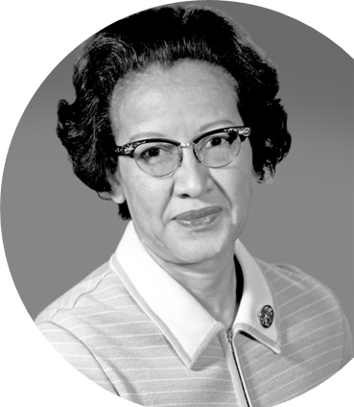
Katherine Johnson
Johnson worked at NASA for 33 years before retiring in 1986. She checked the calculations for John Glenn’s Friendship 7 orbital mission. She also did the calculations which helped synch Project Apollo’s Lunar Module with the lunar-orbiting Command and Service Module. She later worked on the Space Shuttle and the Earth Resources Technology Satellite (ERTS, later renamed Landsat) and authored or coauthored 26 research reports.

Slide 10
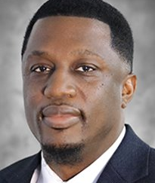
Shaun Washington
Geoscience Analyst at Tudor, Pickering, Holt & Co. He specializes in geospatial analytics/mapping, subsurface data management, G&G applications/software for seismic interpretation, 3D visualization/modeling, well log analysis & GIS in support of geoscientist, petrophysicist, reservoir/production engineers. He also the treasurer for the National Association of Black Geologists.

Slide 11
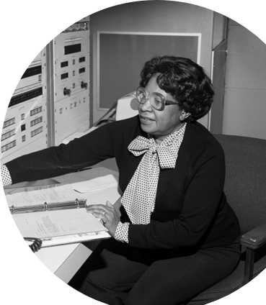
Mary Jackson
She was NASA’s first Black female engineer and co-authored 12 technical papers there. Petitioned to take graduate courses to work on the National Advisory Committee for Aeronautics (NACA) Supersonic Pressure Tunnel. She earned a dual degree in mathematics and physical sciences.

Slide 12
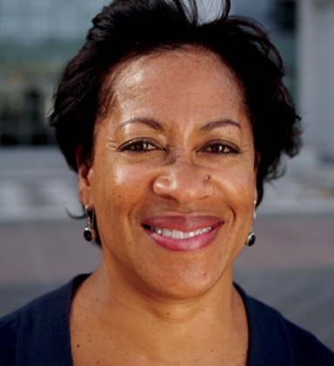
Lisa White
Paleontologist. White was a professor of geosciences and the associate dean of the College of Science and Engineering at San Francisco State University for 22 years. She taught undergraduate classes in paleontology, historical geology, and oceanography, and guided research projects with graduate students in Miocene diatoms of the Monterey Formation of CA, and fossil cold seep assemblages in the Franciscan Complex. In 2015, White was a featured scientist in, NOVA Making of North America, A three-part series. Currently, she works as Assistant Director at University of California Berkeley Museum of Paleontology. White is also currently Chair of the Diversity and Inclusion Advisory Committee for the American Geophysical Union.

Slide 13
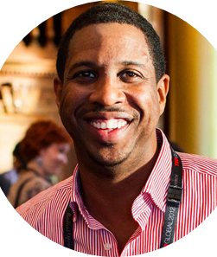
Hakeem Oluseyi
Oluseyi holds three degrees in physics and one in mathematics. He worked with the 2011 Nobel Prize winning Supernova Cosmology Project, developing detectors for a planned space-based telescope that will investigate the nature of the dark energy that is accelerating the universe's expansion.
He is a professor at the Florida Institute of Technology, and a frequent contributor to the Discovery Channel and National Geographic. He has given multiple TED talks and is regularly invited to speak at science forums all around the world. For his science outreach work, he was selected as a 2012 TED Global Fellow.
In 2002, through an organization called Cosmos Education, Hakeem began visiting sub-Saharan African schools to inspire young students with science demonstrations. His advice for students interested in science is to find role models and mentors in shows, books, and in person.

Slide 14
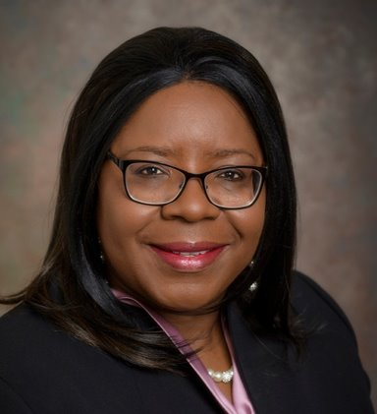
Estella Atekwana
Atekwana is currently the dean of the College of Earth, Ocean and Environment at University of Delaware. She holds a Bachelor's and Master's in Geology from Howard University, as well as a Ph.D. in Geology from Dalhousie University. Her research interests include: Biogeophysics, Near Surface Geophysics, Tectonics, Geodynamics, Continental Rifting, and Structural Geophysics.
Atekwana has received a number of honors and awards for excellence in teaching and research, including the 2016 Society of Exploration Geophysicists Outstanding Educator Award, Regents Professor and the 2015 Oklahoma State University Eminent Faculty Award, which is awarded to a faculty member who has made sustained contributions to scholarly creativity, teaching and service, bringing honor and recognition to Oklahoma State University.

Slide 15
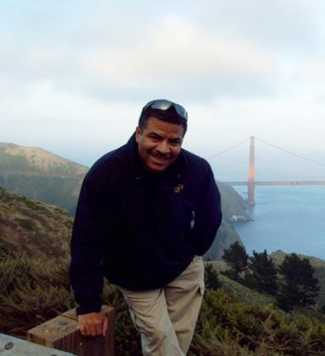
Rufus Catchings
Catchings grew up in a racially segregated North Carolina in the late 1950’s and 1960s. He and his siblings were some of the first African American students integrated into previously segregated schools, following the 1964 Civil Rights Act and Brown v. Board of Education legislation. Catchings completed his bachelor’s degree in Geology from Appalachian State University, master’s degree in Geophysics from the University of Wisconsin-Madison, and Ph.D. in Geophysics from Stanford University. He also did graduate work at the Massachusetts Institute of Technology. His current work includes subsurface research in Beijing, China, Koyna, India, and Vancouver, Canada. Among the accolades for his work, Catchings has been named a Fellow by the Geological Society of America and has been awarded the Department of the Interior Superior Service Award and Unit Award for Excellence of Service, which recognizes significant achievements within natural science. He utilizes techniques called “PGV of Guided Waves” and “Vp/Vs Ratio Mapping” to precisely locate and identify faults. The former method locates faults at the surface using sensors to measure energy traveling within fault zones, and the latter method identifies subsurface faults using the ratio of P- to S-wave velocities.

Slide 16
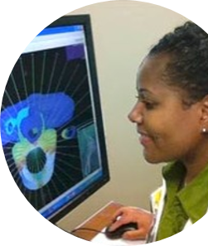
Christina Barrow
Barrow is a medical physicist. She majored in electrical engineering and then worked in server development at Dell Computer Corporation for three years. Afterwards, she went on to accept a position in the biomedical engineering field. At this point, she pursued graduate school in Medical Physics, a combination of modern medicine, math, and physics. Barrow is currently working on a clinical trial project in radiation oncology. If successful, this project will allow VA medical personnel to treat patients using a variety of radiation research protocols and provide them with access to the latest techniques in patient care.

Slide 17
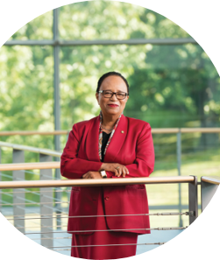
Shirley Ann Jackson
Jackson is a theorhetical physicist and was the first African American woman to earn a PhD from MIT. During her undergraduate work, she was left in social isolation because she was getting an education during a time of heavy discrimination. However, she continued to pursue her education and was determined to build her knowledge in science during these challenging times.
Jackson is the 18th president of Rensselaer Polytechnic Institute, the oldest technological research university in the United States, where she has led an extraordinary transformation since 1999.
She has been appointed by former presidents Clinton and Obama, for separate positions in the government – dedicated to expanding STEM education.

Slide 18
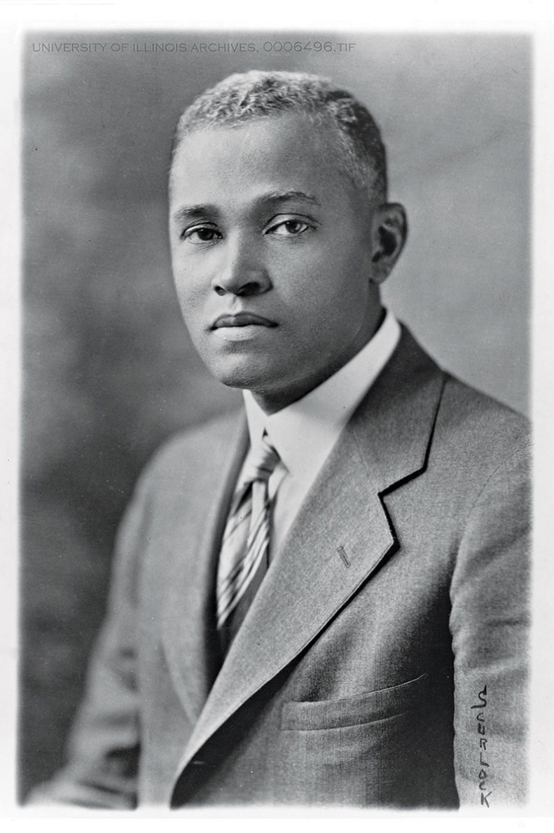
St. Elmo brady
Brady was the first African American to earn a PhD in chemistry and did his graduate work at the University of Illinois Urbana-Champaign.
His research focused on how the acidity of carboxylic acids changed based on the addition of different chemical groups.
He was an instructor at Tuskegee University and later became the chair of the chemistry department at Howard University.
Later, he took over noted Black chemist, Thomas W. Talley’s, position and lead the chemistry department at Fisk University, where he had earned his undergraduate degree.
There, Brady created the nation’s first graduate program in chemistry at a historically Black college. He did this at three other universities.

Slide 19
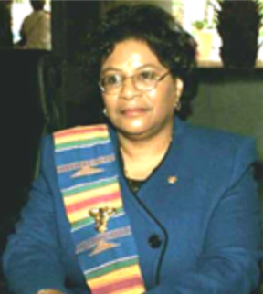
Winifred burks-houck
Burks-Houck was an environmental organic chemist and the first woman president of the National Organization for the Professional Advancement of Black Chemists and Chemical Engineers (1993-2001)
She earned her bachelor’s degree in chemistry at Dillard University, her master’s in organic chemistry at Atlanta University.
She analyzed environmental hazards at the Lawrence Livermore National Laboratory to minimize potential threats to worker safety and limit the environmental impacts of operational labs.
When she was president of the NOBCChE, she advanced partnerships with a variety of chemistry organizations.

Slide 20
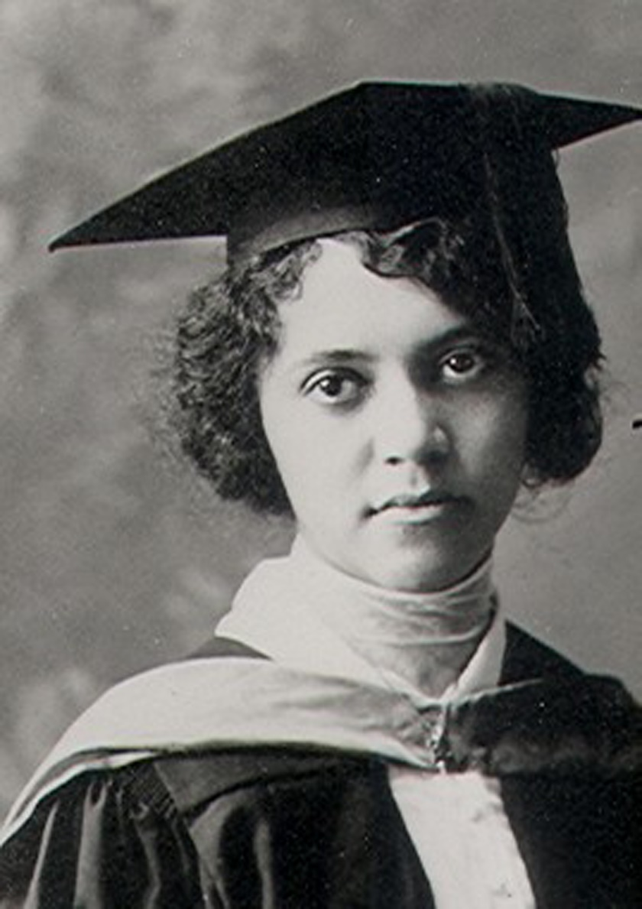
Alice ball
Ball was a chemistry instructor at the College of Hawaii (which later became the University of Hawaii) she also earned her master’s degree in chemistry there.
Ball was the first woman and first Black woman to earn a chemistry degree at the institution.
She discovered how to fractionate the active oil in chaulmoogra, a plant used to treat leprosy, and solubilized it.

